Slide 1
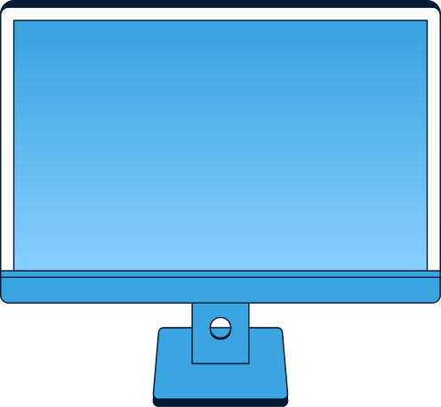
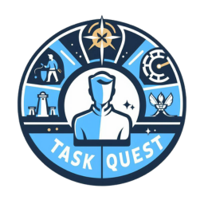
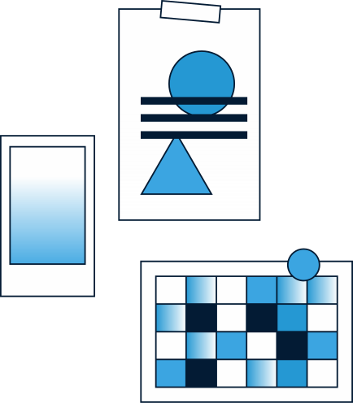
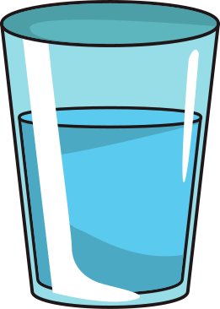

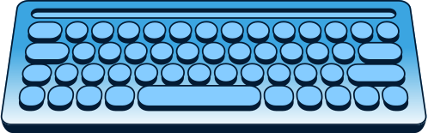

TaskQuest
BY: REIGIS M

Slide 2
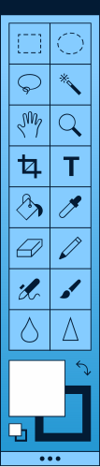

TASK DASHBOARD
Users can create, organise, and prioritise tasks through an intuitive dashboard that displays upcoming tasks, deadlines, and progress.
What Is TaskQuest?
GAMING ELEMENTS
A task management system that includes a leveling system to motivate users to complete tasks.
Integrate game-like features such as experience points and levels to incentivise users to complete tasks and achieve productivity milestones.

Slide 3
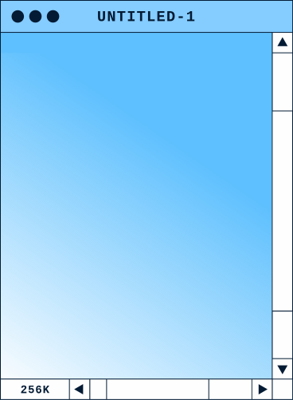
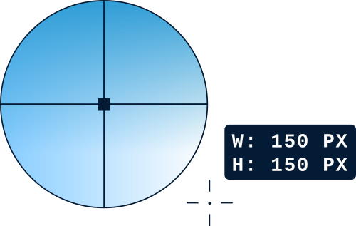
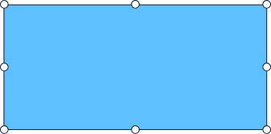
ASANA
Asana is a web and mobile application designed to help teams organise and track their work, facilitating collaboration and project management.
Background & Literature
CENTRICAL
Centrical is a performance management platform that combines personalised gamification, employee engagement, and real-time analytics to drive productivity and business outcomes.
What inspired me to create TaskQuest?

Slide 4

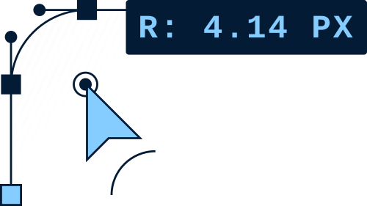
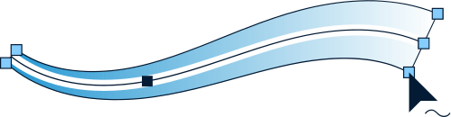
Functional/Non-Functional Requirements
TASK MANAGEMENT
GAMIFICATION FEATURES
TaskQuest allows users to create,edit, and delete tasks as well as set deadlines.
TaskQuest has game-like elements such as XP and levels to motivate users.
USER
INTERFACE
PERFORMANCE
TaskQuest should have a visually appealing interface, ensuring ease and an enjoyable user experience.
The system should be responsive and capable of handling multiple user interactions simultaneously.

Slide 5
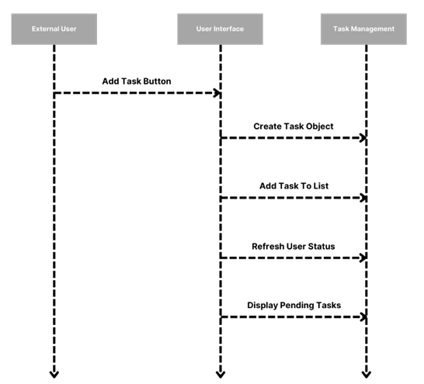
System Design (Sequence Diagram)
KEY:
External User: Triggers the process by clicking the “Add Task” button.
User Interface: Handles the user interface interactions.
Task Management: Manages the creation, addition, and updating of tasks.

Slide 6
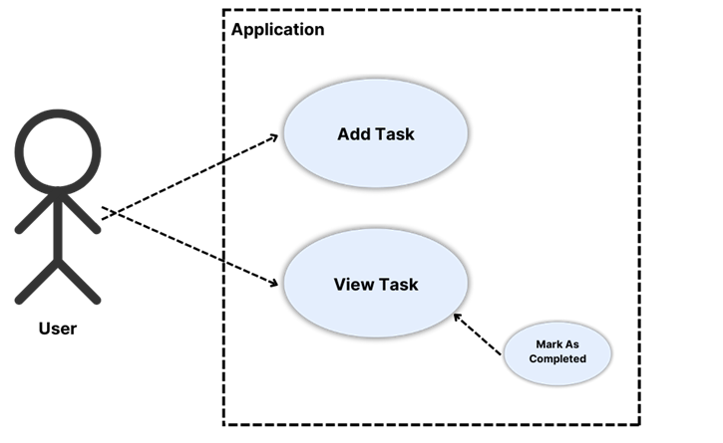
System Design (Use Case Diagram)
KEY:
External User: Represents the users interacting with the system.
Add Task: Use case for adding a new task.
View Task: Use case for viewing tasks.

Slide 7
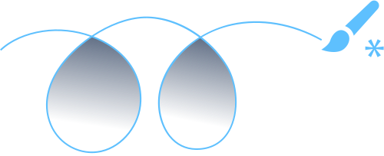
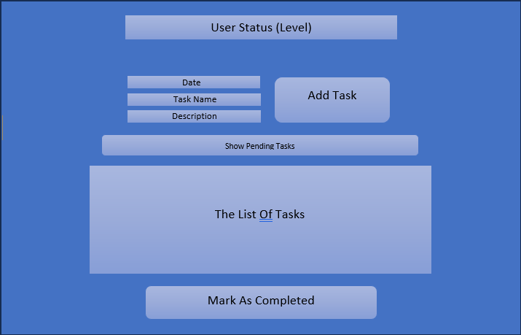
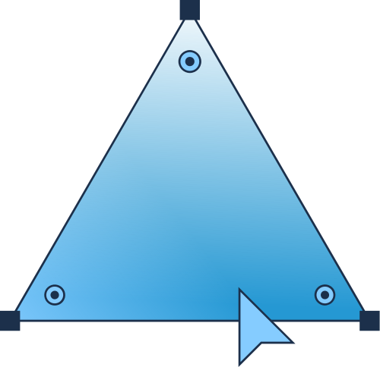
Prototyping
THE PROTOTYPING STAGE WAS A WAY TO DEMONSTRATE THE CORE FEATURES OF THE TASKQUEST PROGRAMME.

Slide 8
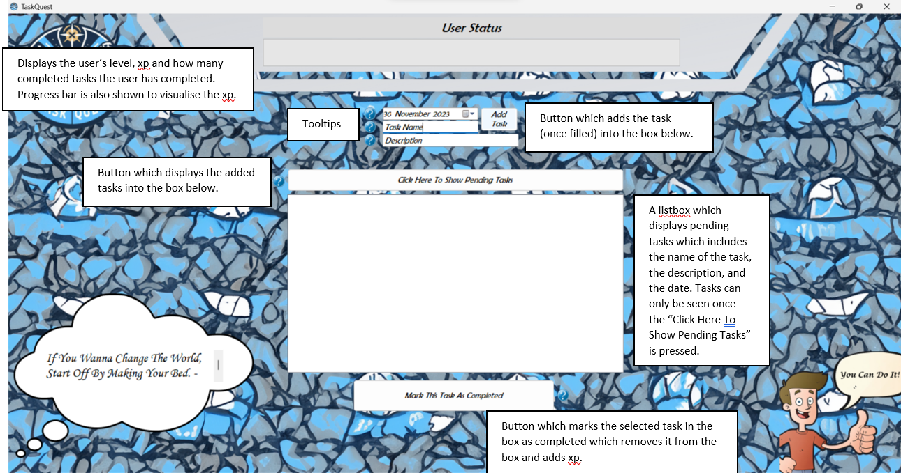
Implementation: Software Screen

Slide 9
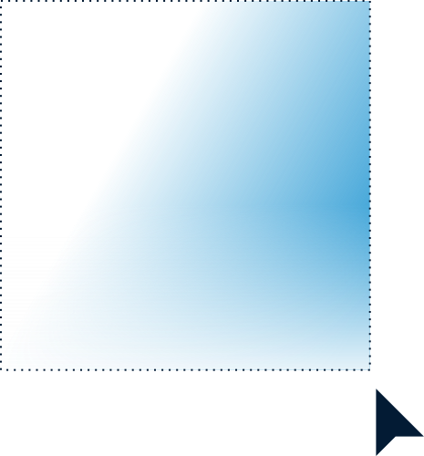
Moving Onto The Code
By: Reigis M

